Slide 1

Question:
What are the functions implemented at the Network Layer (Layer 3)?
Application
Transport
Network
Link
Physical
Notes:
The network layer is in layer 3 of TCP/IP Internet model. It is responsible for delivering packets between endpoints over multiple links, also called multiple Hops.

Slide 2
Review: Functions of the Network Layer
Responsible for delivering packets between the two communication endpoints over multiple hops/links
Basic functions at Layer 3
Routing
IP addressing
Application
Transport
Network
Link
Physical
Notes:
The network layer is in layer 3 of TCP/IP Internet model. It is responsible for delivering packets between endpoints over multiple links, also called multiple Hops.

Slide 3
Network Layer on the Internet
IP Version 4 »
IPv4 Addresses »
Internet Control Protocols »
Notes:
Let’s look at IPv4, IPv6, IP addresses, and routing protocols in network layer.

Slide 4
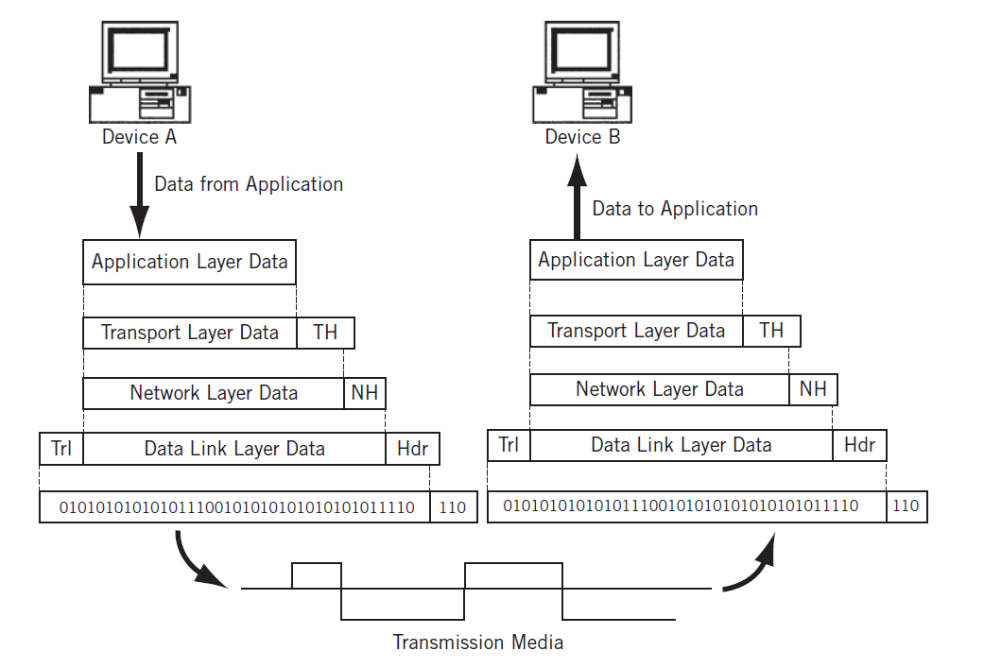


Sender adds a header at each layer

Slide 5
Receiver removes a header at each layer

Slide 6
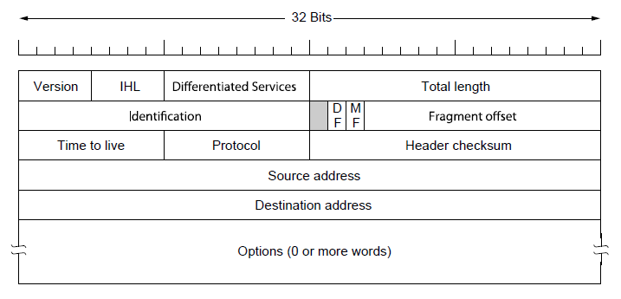

IPv4 Header
IPv4 header has a fixed part (20 bytes) and an optional part (with variable length up to 40 bytes)
Minimum size: 20 bytes
Maximum size: 60 bytes
Notes:
Here it shows all the header fields in an IPv4 packet. [Explain each field]

Slide 7
Fields of IPv4 Header
Version
IHL – IPv4 Header Length in the number of 32-bit words
a 4-bit number
Differentiated services - to distinguish between different classes of service. Originally, it was called the Type of services
Notes:
Here it shows all the header fields in an IPv4 packet. [Explain each field]

Slide 8


Total length - includes both header and data payload
Question: What is the maximum size of an IPv4 packet?
Your answer is: ??? 65,535
Notes:
Here it shows all the header fields in an IPv4 packet. [Explain each field]

Slide 9

Identification – Packet ID that allows destination host to determine which packet a newly-arrived fragment belongs to. All the fragments of a packet contain the same ID number
DF - Don’t Fragment
MF - More Fragments. All fragments of a packet except the last one have this bit set
Fragment offset tells where in the current packet this fragment belongs
Notes:
Here it shows all the header fields in an IPv4 packet. [Explain each field]

Slide 10

A packet is stored at a router until it has fully arrived and then forwarded to the node towards its dest.
Question: How does the router know that a packet has fully arrived?
Notes:
Here it shows all the header fields in an IPv4 packet. [Explain each field]

Slide 11

TTL - a counter for the # of hops from src to dst
When a packet arrives at a router, its TTL decreased by 1
When a packet’s TTL hits zero, it will be discarded by the router and the sender will be notified
Question: Why is the field of TTL needed?
Notes:
to prevent mis-addressed packets from being circulated forever on the Internet

Slide 12
Protocol –the protocol number TCP = 6, UDP = 17
Header checksum – checksum the IPv4 header since the header carries vital information such as IP addresses, it rates its own checksum for protection

Slide 13
Source IP address – 32 bits
Destination IP address – 32 bits
Options - designed to provide an escape to allow subsequent versions of IP to include info not present in the original design (e.g., try out some new ideas)
Notes:
Here it shows all the header fields in an IPv4 packet. [Explain each field]

Slide 14
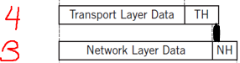
Max Length of a Trans-Layer Segment
Min length of an IP header (NH) is 20 bytes
Max length of an IP packet is 65,535
= 2^16 – 1 (bytes)
Max length of a trans-layer segment is
65,515 = 65,535 – 20 (bytes)

Slide 15
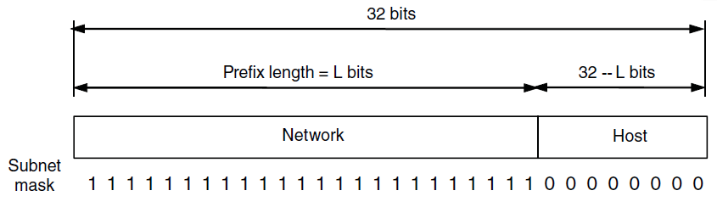
IPv4 Addresses (1) – Prefixes
Each IPv4 address has two portions:
network prefix
A network corresponds to a contiguous block of IP address space. This block is called a network prefix
It has the same value for all hosts on a single network, such as an Ethernet LAN
host address

Slide 16
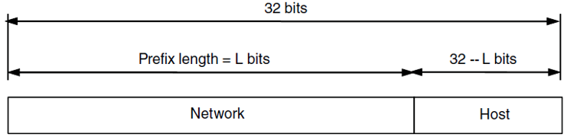
IPv4 Addresses (2) – Prefixes
This hierarchical addressing scheme makes it easier to route packets from source to destination
In CIDR (Classless Inter-Domain Routing) format, an IPv4 address has format a.b.c.d/x
where x represents the Prefix length and 32 - x is the host-address length. E.g., 18.0.31.0/24

Slide 17
Subnet Mask for Old format of IPv4 Addresses
Run >ipconfig on a command line to see the subnet mask of your network
Subnet mask is needed for old format of IPv4 addresses
Subnet mask:
Network prefix bits: all 1’s
Host address bits: all 0’s

Slide 18
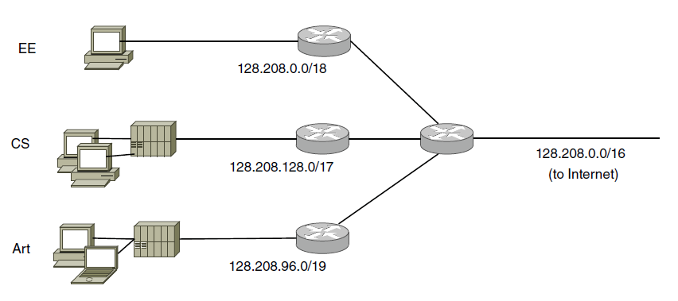


IPv4 Addresses (3) – Subnets
Subnetting splits up IP prefix to help with network management
Under the IP address block: 128.208.0.0/16, we can design three subnets including
128.208.0.0/18
128.208.128.0/17, and
128.208.96.0/19
The most left 16 bits are the same
Router-16
ISP gives each network
a single prefix
A Network is divided into 3 subnets internally
Notes:
This Hierarchical design can benefit CIDR routing. Any packet with destination address prefix 128.208.0.0 will be forwarded to Router-16. Router-16 can further check its destination IP address to decide to forward it to Router -18, or 17, or 19.

Slide 19

IPv4 Addresses (4) – Subnets
Router-16’s IP address is 128.208.0.0/16
The most left 16 bits of the three subnets are the same
128.208.0.0/18 10000000.11010000.00000000.00000000
128.208.128.0/17 10000000.11010000.10000000.00000000
128.208.96.0/19 10000000.11010000.01100000.00000000
Notes:
This Hierarchical design can benefit CIDR routing. Any packet with destination address prefix 128.208.0.0 will be forwarded to Router-16. Router-16 can further check its destination IP address to decide to forward it to Router -18, or 17, or 19.

Slide 20

IPv4 Addresses (5) – Subnets
This IP address hierarchical design can benefit CIDR routing
Any packet from the Internet with dest. address prefix 128.208.*.* will be forwarded to Router-16
Router-16 can further check its dest. IP address to decide to forward it to which subnet (Router-18, or -17, or -19)
Router-16
ISP gives each network
a single prefix
Network divides it into subnets internally

Slide 21
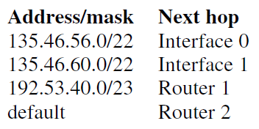

In-class Exercises
A router has the following (CIDR) entries in its routing table:
Question: The router will forward the packet to which interface or router in the next-hop column if a packet with that the dest. IP address 192.53.40.7 arrives?

Slide 22

A Discussion Question
Is the IP address of each host in a computer lab private or public? Why?

Slide 23
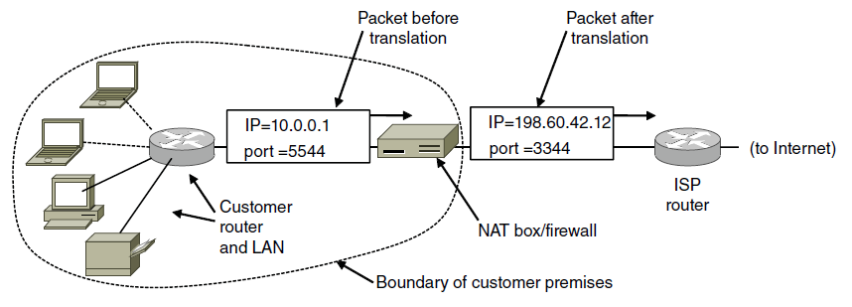

NAT (Network Address Translation)
allows many internal hosts to share a single public IP address to access the Internet
maps a public IP address to many private IP addresses of local hosts in a LAN
Notes:
NAT-Network Address Translation, is used to solve the problem of IPv4 address exhaustion. The basic idea is to share one Internet IP address by multiple hosts in a network.

Slide 24

NAT (2)
solves the problem of IPv4-address exhaustion
more secure and cost-effective
Notes:
NAT-Network Address Translation, is used to solve the problem of IPv4 address exhaustion. The basic idea is to share one Internet IP address by multiple hosts in a network.

Slide 25




Illustration of How NAT Works: A browser at local host 10.0.0.1 wants to access a Web server Steps 1 & 2: outgoing HTTP request from 10.0.0.1 Steps 3 & 4: incoming HTTP response to 10.0.0.1
NAT address translation table
WAN side addr LAN side addr
2: NAT router
changes datagram
source addr/port from
10.0.0.1, 3345 to
138.76.29.7, 5001,
updates table
1: host 10.0.0.1
sends datagram to
128.119.40.186, 80
138.76.29.7, 5001 10.0.0.1, 3345
…… ……
S: 10.0.0.1, 3345
D: 128.119.40.186, 80
10.0.0.1
1
2
S: 138.76.29.7, 5001
D: 128.119.40.186, 80
10.0.0.4
10.0.0.2
138.76.29.7
S: 128.119.40.186, 80
D: 10.0.0.1, 3345
4
S: 128.119.40.186, 80
D: 138.76.29.7, 5001
3
10.0.0.3
4: NAT router
changes datagram
dest. addr/port from
138.76.29.7, 5001 to 10.0.0.1, 3345
3: reply arrives
dest. addr/port:
138.76.29.7, 5001
Notes:
[Explain how NAT works using this example]

Slide 26
Internet Control Protocols
IP has three deficiencies−
Lack of Error Control
Lack of assistance mechanisms
A structure is not available for queries between hosts and the network management server
IP cannot work alone. It works with the help of several Internet control protocols such as:
DHCP (layer 5)
ICMP (layer 3)
ARP (layer 2)
Notes:
IP does not work alone. It works with the help of several Internet control protocols: ICMP, ARP, and DHCP.

Slide 27
DHCP
DHCP (layer 5) dynamically assigns an IP address to a host
Allows a host started by automatically configuring it
A host sends a request to the DHCP server, which grants a leased IP dynamically
A big advantage of using DHCP is the ability to join a network and receive an IP without knowing detail about it
E.g., in a coffee shop, with DHCP enabled on your computer, you can go online automatically
Details about how DHCP works?

Slide 28
ICMP (Internet Control Message Protocol)
Implemented at layer 3 to
troubleshoot a network, and
report some error messages for packet communication
Created to compensate for IP’s deficiencies
Implementation required for TCP/IP networks
ICMP-related command tools
ping (test the reachability of a host)
traceroute or tracert (display possible routes and measure transit delays of packets)

Slide 29
Output of traceroute or tracert
Run the following command on Windows:
>tracert -d 8.8.8.8
Column 1: Hop #
Columns 2, 3 and 4: the RTT Columns
display the round-trip time (RTT) for your packet to reach the destination host and return to the source host
There are three columns because the traceroute sends three separate signal packets

Slide 30
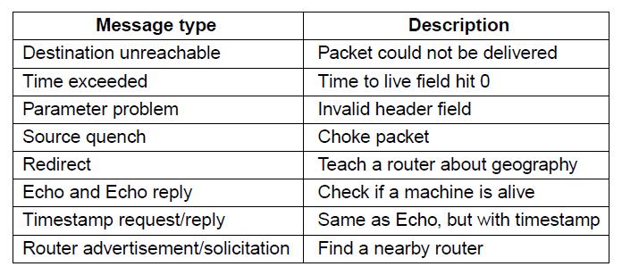

ICMP Message Types
The table below shows some ICMP message types
Notes:
ICMP-Internet Control Message Protocol, is used to debug a network, and report some packet communication error messages. Here it shows some message types. [Explain each one using this table]

Slide 31
A Discussion Question
ICMP should be disenabled in mission-critical servers. Why?

Slide 32
ARP
ARP (layer 2) finds Mac address for a given IP address
Needed at Layer 2, a part of Layer 2 header info
Used to find the Mac address for the given destination IP address
Needed so that a layer 3 packet can be correctly addressed when they are encapsulated as a layer 2 frame
Each host maintains an ARP cache table
a table of ARP entries created and stored when an IP address is resolved to an MAC address

Slide 33
When is ARP needed?

Slide 34
Review Questions
What is the minimum length of an IPv4 header?
What is stored in each of the following fields in an IPv4 header? (a) the total length; (b) TTL; (c) MF; (d) Protocol.
What is the benefit of having an "options" field in an IPv4 header?
What is the network prefix length of the IP address 18.0.31.0/24?
What is the host address length of the IP address 18.0.31.0/24?
What are the benefits of the hierarchical design of IP addresses?
What is NAT used for? Explain how NAT works using an example
What are the commonly used Internet control protocols that works with the IP protocol? Describe each of them
If the TTL value of a packet becomes 0, what happens to the packet? What type of ICMP message will be sent back to the sender?

